Slide 1

LEAN SIX SIGMA PROJECT STORY BOARD
GB
Improve Timeliness for PSL Editorial
Project Type : Green Belt
Division : Publishing and Editorial Operations
Team Name : LNUK PSL Editorial
Date : July 2018
GB Lead : Rommel Adrian Isleta
Project ID : 5098

Slide 2
MILESTONES
Define
Analyze
Improve
Control
December 2017
February 2018
March
April
June
Measure
2018
2018
2018
2

Slide 3
EXECUTIVE SUMMARY
Project Start Date: December 2017
Project End Date: August 2018
Project Description From July to December 2017, the LNUK PSL Editorial teams in the UK and REPH have completed an average of 968 tasks out of 1551 within the due date, resulting in a timeliness rate of 62.41%. This has resulted in delays in customer engagements and published content as well as an increase in the overall backlog of the team. Project Objective Increase the timeliness rate of PSL Editorial from 62% to 80% by May 2018. | Root Causes Lack of a timeliness scorecard measure Lack of communication on reallocation between the three offices Cover editors need to diligently check plate of editor who's away Editing too quickly the first time Editors allowing the tasks to have due dates not following the TAT guidelines Editors not following up on tasks at author review Documents staying at Author Review for too long but due date is not adjusted Large volume of tasks assigned with the same due date Authors adding instructions to tasks that have already been completed instead of creating new tasks for the same document
Implemented Improvements Daily timeliness measurement Reallocation game plan between LON, MNL and ILO PTO cover arrangements Thorough proofreading and copyediting work during Editing phase Changing due dates according to TAT guidelines Following up on tasks at Author Review | Final Result Improved overall timeliness rate of PSL Editorial from 62% to 84% Generated annualized savings of USD 82,798
3

Slide 4
Define
Measure
Control
Analyze
Improve
Project Lead: Rommel Adrian Isleta
Problem Statement:
From July to December 2017, the LNUK PSL Editorial teams in the UK and REPH-MNL have completed an average of 968 tasks out of 1551 within the due date, resulting in a timeliness rate of 62.41%. This has resulted in delays in customer engagements and published content as well as an increase in the overall backlog of the team.
Objective:
Increase the timeliness rate of PSL Editorial from 62% to 80% by May 2018.
Scope:
All PSL Editors in London, Manila and Iloilo
Tasks with technical issues are excluded from this project.
Tasks completed by editors who have not yet completed certification are excluded
Benefits:
More timely completion of tasks
Increase in productivity
Regular monitoring of the timeliness metric for better performance management; inclusion of timeliness as one of the scorecard metrics for REPH editors
Better customer engagement
Project Sponsor: Sheryll Prado
Project Team: LNUK PSL Editorial
MCM: Rick Dols
Department: REPH-PEO
Process Owners: Luke Kenison, Ngozi Ikeyina
Project Team Members:
Mikaella Darum Operations Supervisor (REPH-MNL)
Andrea Villamero Operations Supervisor (REPH-ILO)
Shekienah Light Pueyo Operations Supervisor (REPH-ILO)
Stephen Nixey Lead PG Editor (LNG-LON)
Kielan Thompson Senior Editor (LNG-LON)
Rhodora Josefa Molina Legal Editor (REPH-ILO)
Ara Bea Hernandez Content Editor II (REPH-MNL)
Rodjiene Mislan Content Editor (REPH-MNL)
Regine Gandullas Content Editor (REPH-MNL)
Leira Miralles Content Editor (REPH-MNL)
Carmen Regina Punayo Content Editor (REPH-MNL)
Eleanor Bramall PSL Digital Editor (LNG-LON)
Ma. Ellaiza Janda-berroy PSL Digital Editor (REPH-MNL)
4
Notes:
FYI: All information can be found in your project charter.

Slide 5
Define
Measure
Control
Analyze
Improve
SIPOC
S |  | I |  | P |  | O |  | C
Suppliers |  | Inputs |  | Process |  | Outputs |  | Customers
 |  |  |  | Document Creation and Updating
 |  | New/Updated Practical Guidance Document |  |  |  | Updated XML documents |  | PSL Authors
PSL Authors |  |  |  |  |  |  |  | Law Firms
 |  |  |  | Editing
PSL Editors |  | LexisPSL House Style |  |  |  | Updated LexisPSL site |  | LexisPSL Subscribers
 |  | ECHo |  | Author Review
 |  |  |  | Editorial Review |  | Customer Requirements
 |  | Arbortext
 |  |  |  |  |  | complete and up-to-date LexisPSL Practice Notes, Precedents, Checklists, and Q&As
 |  |  |  | Publishing
 |  |  |  | Check Online
5

Slide 6
Define
Measure
Control
Analyze
Improve
Baseline Performance Measure
Metric | Operational Definition | Calculation Formula | Source | Unit of Measure | Data Type | Baseline | Goal
Timeliness Rate | Percentage of tasks completed within due date over total tasks completed (excluding tech issues and tasks completed during certification) | Total tasks completed within due date ÷ Total tasks completed | Asana Timeliness Calculator | % | Discrete | 62% | 80%
Monthly Data
Month | UK |  | MNL |  | ILO |  | TOTAL |  | TIMELINESS RATE
 | completed | w/in TAT | completed | w/in TAT | completed | w/in TAT | completed | w/in TAT | UK | MNL | ILO | TOTAL
July | 313 | 162 | 1195 | 720 | 129 | 96 | 1637 | 978 | 51.76% | 60.25% | 74.42% | 59.74%
August | 348 | 185 | 1221 | 707 | 95 | 66 | 1664 | 958 | 53.16% | 57.90% | 69.47% | 57.57%
September | 375 | 227 | 1253 | 654 | 49 | 38 | 1677 | 919 | 60.53% | 52.19% | 77.55% | 54.80%
October | 382 | 255 | 1218 | 731 | 45 | 41 | 1645 | 1027 | 66.75% | 60.02% | 91.11% | 62.43%
November | 371 | 279 | 1269 | 898 | 7 | 6 | 1647 | 1183 | 75.20% | 70.76% | 85.71% | 71.83%
December | 281 | 185 | 757 | 559 | 0 | 0 | 1038 | 744 | 65.84% | 73.84% | 0.00% | 71.68%
TOTAL | 2070 | 1293 | 6913 | 4269 | 325 | 247 | 9308 | 5809 | 62.46% | 61.75% | 76.00% | 62.41%
6

Slide 7
Define
Measure
Control
Analyze
Improve
Weekly Data
Week | UK |  | MNL |  | ILO |  | TOTAL |  | TIMELINESS RATE
 | completed | w/in TAT | completed | w/in TAT | completed | w/in TAT | completed | w/in TAT | UK | MNL | ILO | TOTAL
Jul 3-7 | 85 | 41 | 318 | 208 | 22 | 19 | 425 | 268 | 48.24% | 65.41% | 86.36% | 63.06%
Jul 10-14 | 87 | 42 | 265 | 182 | 19 | 13 | 371 | 237 | 48.28% | 68.68% | 68.42% | 63.88%
Jul 17-21 | 73 | 36 | 263 | 154 | 36 | 25 | 372 | 215 | 49.32% | 58.56% | 69.44% | 57.80%
Jul 24-28 | 78 | 48 | 328 | 193 | 41 | 31 | 447 | 272 | 61.54% | 58.84% | 75.61% | 60.85%
Jul 31-Aug 4 | 77 | 37 | 325 | 145 | 18 | 11 | 420 | 193 | 48.05% | 44.62% | 61.11% | 45.95%
Aug 7-11 | 86 | 44 | 311 | 158 | 31 | 21 | 428 | 223 | 51.16% | 50.80% | 67.74% | 52.10%
Aug 14-18 | 105 | 60 | 258 | 141 | 17 | 15 | 380 | 216 | 57.14% | 54.65% | 88.24% | 56.84%
Aug 21-25 | 63 | 40 | 277 | 201 | 17 | 15 | 357 | 256 | 63.49% | 72.56% | 88.24% | 71.71%
Aug 28-Sep 1 | 39 | 26 | 34 | 16 | 35 | 23 | 108 | 65 | 66.67% | 47.06% | 65.71% | 60.19%
Sep 4-8 | 69 | 42 | 215 | 122 | 20 | 15 | 304 | 179 | 60.87% | 56.74% | 75.00% | 58.88%
Sep 11-15 | 64 | 32 | 317 | 175 | 8 | 7 | 389 | 214 | 50.00% | 55.21% | 87.50% | 55.01%
Sep 18-22 | 103 | 56 | 382 | 172 | 1 | 0 | 486 | 228 | 54.37% | 45.03% | 0.00% | 46.91%
Sep 25-29 | 107 | 75 | 376 | 214 | 7 | 4 | 490 | 293 | 70.09% | 56.91% | 57.14% | 59.80%
Oct 2-6 | 102 | 62 | 348 | 205 | 5 | 1 | 455 | 268 | 60.78% | 58.91% | 20.00% | 58.90%
Oct 9-13 | 83 | 62 | 283 | 174 | 8 | 8 | 374 | 244 | 74.70% | 61.48% | 100.00% | 65.24%
Oct 16-20 | 77 | 52 | 232 | 131 | 13 | 13 | 322 | 196 | 67.53% | 56.47% | 100.00% | 60.87%
Oct 23-27 | 104 | 75 | 255 | 171 | 18 | 18 | 377 | 264 | 72.12% | 67.06% | 100.00% | 70.03%
Oct 30-Nov 3 | 84 | 55 | 262 | 149 | 6 | 5 | 352 | 209 | 65.48% | 56.87% | 83.33% | 59.38%
Nov 6-10 | 107 | 73 | 299 | 205 | 3 | 3 | 409 | 281 | 68.22% | 68.56% | 100.00% | 68.70%
Nov 13-17 | 61 | 45 | 289 | 211 | 0 | 0 | 350 | 256 | 73.77% | 73.01% | 0.00% | 73.14%
Nov 20-24 | 88 | 69 | 290 | 213 | 0 | 0 | 378 | 282 | 78.41% | 73.45% | 0.00% | 74.60%
Nov 27-Dec 1 | 76 | 61 | 258 | 194 | 0 | 0 | 334 | 255 | 80.26% | 75.19% | 0.00% | 76.35%
Dec 4-8 | 57 | 33 | 237 | 191 | 0 | 0 | 294 | 224 | 57.89% | 80.59% | 0.00% | 76.19%
Dec 11-15 | 87 | 48 | 248 | 169 | 0 | 0 | 335 | 217 | 55.17% | 68.15% | 0.00% | 64.78%
Dec 18-22 | 108 | 79 | 243 | 175 | 0 | 0 | 351 | 254 | 73.15% | 72.02% | 0.00% | 72.36%
TOTAL | 2070 | 1293 | 6913 | 4269 | 325 | 247 | 9308 | 5809 | 62.46% | 61.75% | 76.00% | 62.41%
7

Slide 8
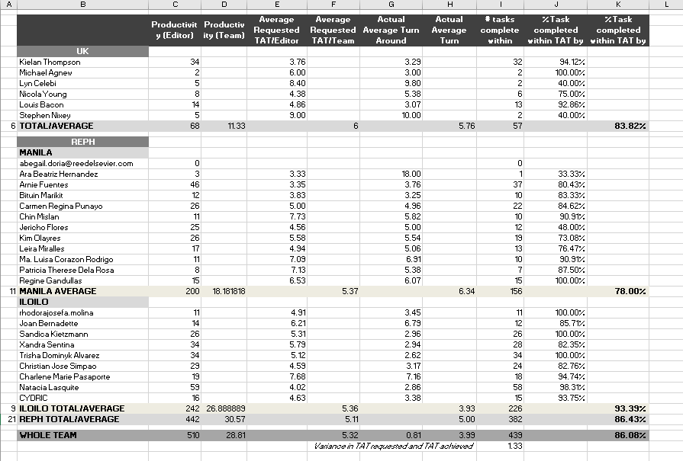
Define
Measure
Control
Analyze
Improve
8

Slide 9
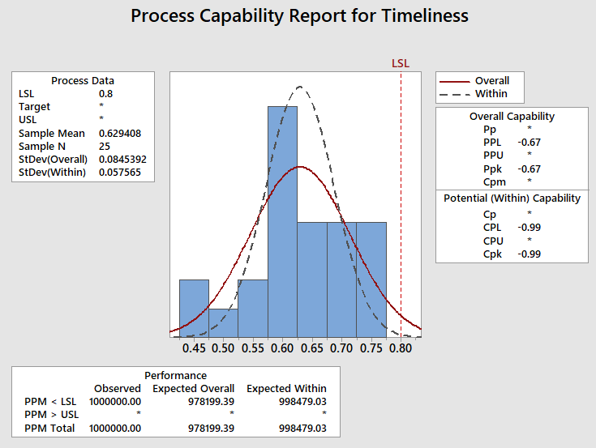
Define
Measure
Control
Analyze
Improve
Process Capability—Baseline
9
Notes:
Process capability index—negative Cpk value indicates that process is not capable of achieving the target of 80%

Slide 10
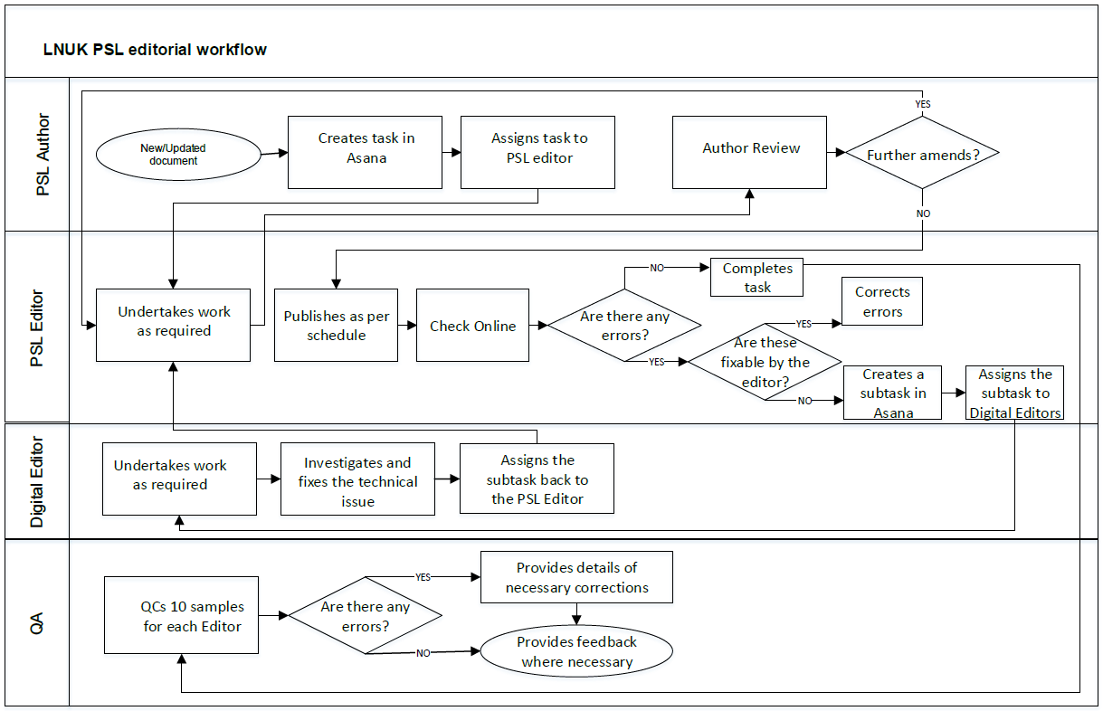
Define
Measure
Control
Analyze
Improve
Process Map
10

Slide 11
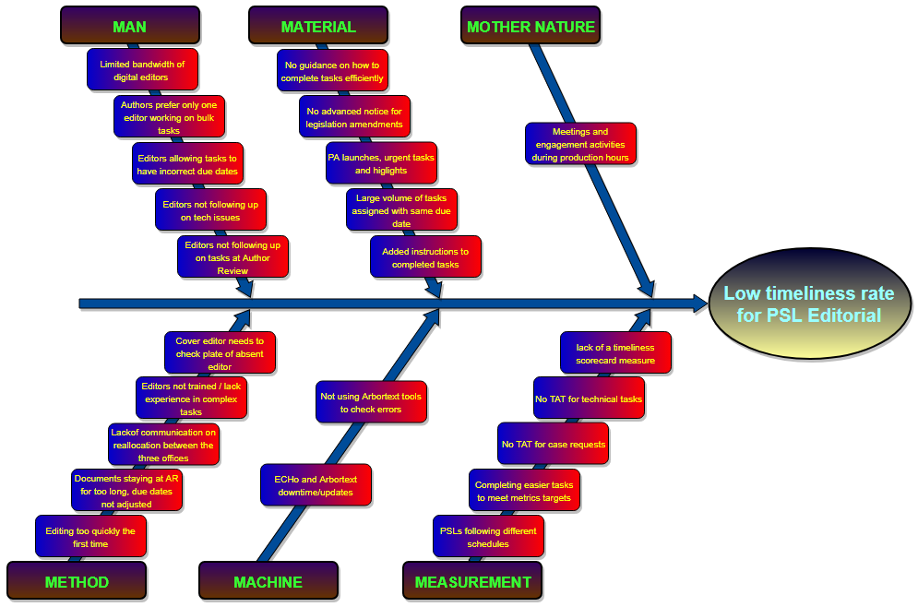
Fishbone Diagram / 5 Whys
Define
Measure
Analyze
Improve
Control
11
Notes:
23 unique potential root causes

Slide 12
Prioritization Matrix
Define
Measure
Control
Analyze
Improve
# | POTENTIAL ROOT CAUSE | SEVERITY | OCCURRENCE | LIKELIHOOD TO BE RESOLVED IN 2 MONTHS | SCORE | % | CUMULATIVE
1 | Lack of a timeliness scorecard measure | 10 | 10 | 10 | 1000 | 13.63% | 13.63%
2 | Lack of communication on reallocation between the three offices | 9 | 10 | 10 | 900 | 12.27% | 25.90%
3 | Cover editors need to diligently check plate of editor who's away | 9 | 9 | 10 | 810 | 11.04% | 36.95%
4 | Editing too quickly the first time | 8 | 9 | 10 | 720 | 9.82% | 46.76%
5 | Editors allowing the tasks to have due dates not following the TAT guidelines | 9 | 9 | 8 | 648 | 8.83% | 55.60%
6 | Editors not following up on tasks at author review | 8 | 6 | 10 | 480 | 6.54% | 62.14%
7 | Documents staying at Author Review for too long but due date is not adjusted | 10 | 6 | 8 | 480 | 6.54% | 68.68%
8 | Large volume of tasks assigned with the same due date | 10 | 6 | 8 | 480 | 6.54% | 75.23%
9 | Authors adding instructions to tasks that have already been completed instead of creating new tasks for the same document | 10 | 4 | 8 | 320 | 4.36% | 79.59%
10 | PA launches, urgent tasks and highlights takes precedence over BAU tasks | 10 | 7 | 4 | 280 | 3.82% | 83.41%
11 | Author's preference to only have one editor work on bulk tasks | 7 | 5 | 6 | 210 | 2.86% | 86.27%
12 | Limited bandwidth of digital editors to resolve tech issues | 10 | 6 | 3 | 180 | 2.45% | 88.73%
13 | Editor not trained/lacks experience in handling more complex tasks | 7 | 5 | 5 | 175 | 2.39% | 91.11%
14 | Not using Arbortext tools to check for errors | 4 | 4 | 10 | 160 | 2.18% | 93.29%
15 | No TAT for case requests | 6 | 4 | 5 | 120 | 1.64% | 94.93%
16 | Editors not following up on tech issues | 7 | 2 | 5 | 70 | 0.95% | 95.88%
17 | No advanced notice for legislation/regulation amendments | 10 | 7 | 1 | 70 | 0.95% | 96.84%
18 | Completing easier tasks to meet metrics target | 7 | 9 | 1 | 63 | 0.86% | 97.70%
19 | No TAT for technical tasks | 10 | 6 | 1 | 60 | 0.82% | 98.51%
20 | No definitive guidance on how to efficiently complete a task | 5 | 3 | 3 | 45 | 0.61% | 99.13%
21 | PSLs follow a different schedule, which is not visible to editors | 8 | 4 | 1 | 32 | 0.44% | 99.56%
22 | Meetings and engagement activities overlapping production hours | 7 | 1 | 4 | 28 | 0.38% | 99.95%
23 | ECHo and Arbortext downtime/updates | 2 | 2 | 1 | 4 | 0.05% | 100.00%
 |  |  |  |  | 7335 | 100.00%
12

Slide 13
Define
Measure
Control
Analyze
Improve
Prioritized Root Causes
# | PRIORITISED ROOT CAUSE
1 | Lack of a timeliness scorecard measure
2 | Lack of communication on reallocation between the three offices
3 | Cover editors need to diligently check plate of editor who's away
4 | Editing too quickly the first time
5 | Editors allowing the tasks to have due dates not following the TAT guidelines
6 | Editors not following up on tasks at author review
7 | Documents staying at Author Review for too long but due date is not adjusted
8 | Large volume of tasks assigned with the same due date
9 | Authors adding instructions to tasks that have already been completed instead of creating new tasks for the same document
13

Slide 14
Define
Measure
Control
Analyze
Improve
Pilot Plan
ID | Root Cause | Improvement Solutions | Pilot Start | Pilot End | Owner/POC
1 | Lack of a timeliness scorecard measure | Implementation of a daily timeliness measurement for all PSL editors: All CSVs collected from the start of shift report to be used for computing the timeliness measures for the previous day Reporting of figures will be on a weekly basis (every Monday) but timeliness rate is to be monitored everyday, both on the individual and team level Immediate leaders to be alerted if any editor has been consistently scoring below 80% (eg 3 consecutive days, or depending on the trend of the data or running average is below 80%) | 2 April | 20 April | Rommel Ellai
2 | Lack of communication on reallocation between the three offices | Reallocation game plan between the LON, MNL and ILO offices near the start of the shift: MNL and ILO to reallocate internally at around 1430 PH time during standup meetings; editors are expected to complete all due today tasks MNL and ILO supervisors/POCs to reallocate tasks between the two offices by 3:00 pm PHT LON office to be involved in the reallocation of Level II tasks at around 1600 PH time | 1 March | 29 March | Mark and Bea Sky and Dhors Kielan
14

Slide 15
Define
Measure
Control
Analyze
Improve
ID | Root Cause | Improvement Solutions | Pilot Start | Pilot End | Owner/POC
3 | Cover editors need to diligently check plate of editor who's away | Editor on PTO to ensure that cover arrangements are in place; if leave is more than 2 days, authors should be notified Covering editor should be added as a member of the relevant Practice Area and should check the task list of the editor on leave for any of the following: new tasks, tasks not yet worked on, and urgent tasks | 15 April | 30 April | Mika
4 | Editing too quickly the first time, resulting in errors found in the live site that need to be reworked | All proofreading and copyediting work (ie house style, grammar, typos, consistency) should be performed during the Editing phase in the xml document Editors should make use of the FR and Link Check tool should be used before file is saved back to ECHo Check online should ideally be done to check for links not working and content not appearing correctly in the live site | 15 April | 30 April | Bea
5 | Editors allowing the tasks to have due dates not following the TAT guidelines | Editor to change the due date to the correct due date according to the TAT guidelines | 15 April | 30 April | Ayns
6 | Editors not following up on tasks at author review | More diligent follow-up on tasks that have been at Author Review for more than a day (done by making a comment in Asana) Editor to ask for a reasonable extension should the task go beyond the due date after being routed to Author Review | 15 April | 30 April | Reg
15

Slide 16
Define
Measure
Control
Analyze
Improve
ID | Root Cause | Improvement Solutions | Pilot Start | Pilot End | Owner/POC
7 | Documents staying at Author Review for too long but due date is not adjusted | Authors to adjust due dates for the following scenarios: Documents spending a significant amount of time at Author Review New documents for conversion (if due date is within 5 days or less as it takes 2-3 days to get the converted files from SPi) | 15 April | 30 April | Lei Stephen Kielan
8 | Large volume of tasks assigned with the same due date | Added consideration should be placed in assigning due dates to multiple tasks with a high degree of complexity Depending on the situation, editors can negotiate with the author to move the due dates of all assignments at a later time or to have a certain number of these tasks to be due at a later date | 15 April | 30 April | Chin Stephen Kielan
9 | Authors adding instructions to tasks that have already been completed instead of creating new tasks for the same document | Once Asana task has been completed, it should stay as Completed unless any of the original instructions/requirements have not been met Should there be additional amendments to a document, a new Asana task needs to be created for this—the editor needs to inform the author that this is the best practice, as we have metrics to monitor | 15 April | 30 April | Lei Stephen Kielan
16

Slide 17
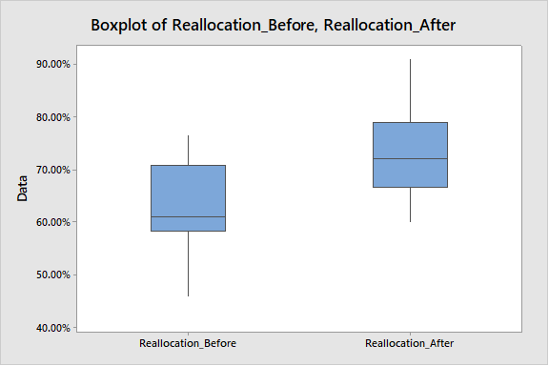
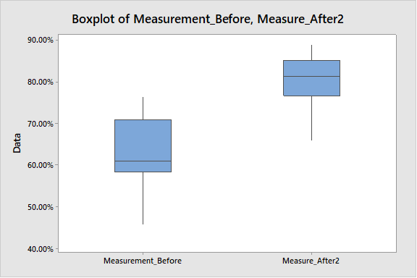
Define
Measure
Control
Analyze
Improve
Pilot Solutions
Reallocation game plan
Daily timeliness measurement
17
Notes:
Baseline: 62.41%
Reallocation: 72.97%
Daily timeliness measurement: 78.71%

Slide 18
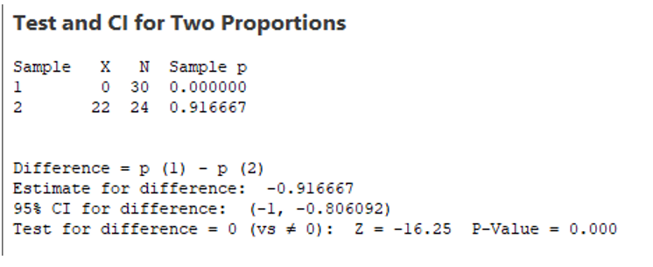
Define
Measure
Control
Analyze
Improve
Pilot Solutions
Tasks not following TAT guidelines
18
Notes:
Root cause # 5

Slide 19
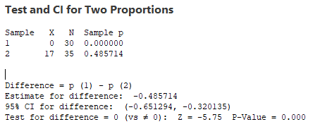
Define
Measure
Control
Analyze
Improve
Pilot Solutions
Editors not following up on tasks at Author Review
19
Notes:
Root cause # 6

Slide 20
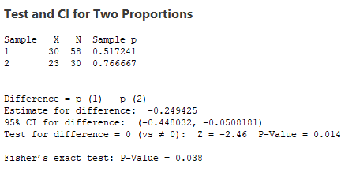
Define
Measure
Control
Analyze
Improve
Pilot Solutions
Large volume of tasks assigned with same due date
20
Notes:
Root cause # 8

Slide 21
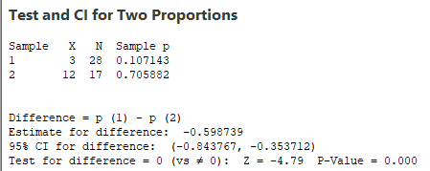
Define
Measure
Control
Analyze
Improve
Pilot Solutions
Authors adding instructions to tasks that have already been completed
21
Notes:
Root cause # 9

Slide 22
Define
Measure
Control
Analyze
Improve
Improve Performance Measure
Metric | Operational Definition | Calculation Formula | Source | Unit of Measure | Data Type | Baseline | Target | Improve
Timeliness Rate | Percentage of tasks completed within due date over total tasks completed (excluding tech issues and tasks completed for cert) | Total tasks completed within due date ÷ Total tasks completed | Asana Timeliness Calculator | % | Discrete | 62% | 80% | 84%
Weekly Data
Week | UK |  | MNL |  | ILO |  | TOTAL |  | TIMELINESS RATE |  |  |  | TARGET
 | completed | w/in TAT | completed | w/in TAT | completed | w/in TAT | completed | w/in TAT | UK | MNL | ILO | TOTAL
April 22-April 28 | 79 | 66 | 296 | 229 | 111 | 97 | 486 | 392 | 83.54% | 77.36% | 87.39% | 80.66% | 80%
April 29-May 5 | 76 | 59 | 255 | 206 | 140 | 129 | 471 | 394 | 77.63% | 80.78% | 92.14% | 83.65% | 80%
May 6-May 12 | 115 | 83 | 218 | 169 | 117 | 104 | 450 | 356 | 72.17% | 77.52% | 88.89% | 79.11% | 80%
May 13-May 19 | 138 | 114 | 267 | 251 | 114 | 93 | 519 | 458 | 82.61% | 94.01% | 81.58% | 88.25% | 80%
May 20-May 26 | 98 | 70 | 286 | 272 | 177 | 161 | 561 | 503 | 71.43% | 95.10% | 90.96% | 89.66% | 80%
May 27-June 2 | 151 | 79 | 211 | 199 | 122 | 107 | 484 | 385 | 52.32% | 94.31% | 87.70% | 79.55% | 80%
June 3-June 9 | 114 | 95 | 222 | 200 | 162 | 149 | 498 | 444 | 83.33% | 90.09% | 91.98% | 89.16% | 80%
June 10-June 16 | 84 | 77 | 205 | 173 | 183 | 165 | 472 | 415 | 91.67% | 84.39% | 90.16% | 87.92% | 80%
June 17-June 23 | 104 | 94 | 200 | 167 | 193 | 155 | 497 | 416 | 90.38% | 83.50% | 80.31% | 83.70% | 80%
June 24-June 30 | 128 | 106 | 253 | 202 | 163 | 146 | 544 | 454 | 82.81% | 79.84% | 89.57% | 83.46% | 80%
July 1-July 7 | 80 | 72 | 286 | 221 | 236 | 219 | 602 | 512 | 90.00% | 77.27% | 92.80% | 85.05% | 80%
July 8-July 14 | 95 | 77 | 216 | 181 | 251 | 208 | 562 | 466 | 81.05% | 83.80% | 82.87% | 82.92% | 80%
July 15-July 21 | 56 | 50 | 274 | 203 | 205 | 199 | 535 | 452 | 89.29% | 74.09% | 97.07% | 84.49% | 80%
July 22-July 28 | 68 | 57 | 200 | 156 | 242 | 226 | 510 | 439 | 83.82% | 78.00% | 93.39% | 86.08% | 80%
July 29-August 4 | 96 | 76 | 298 | 227 | 238 | 220 | 632 | 523 | 79.17% | 76.17% | 92.44% | 82.75% | 80%
TOTAL | 1482 | 1175 | 3687 | 3056 | 2654 | 2378 | 7823 | 6609 | 79.28% | 82.89% | 89.60% | 84.48% | 80%
22

Slide 23
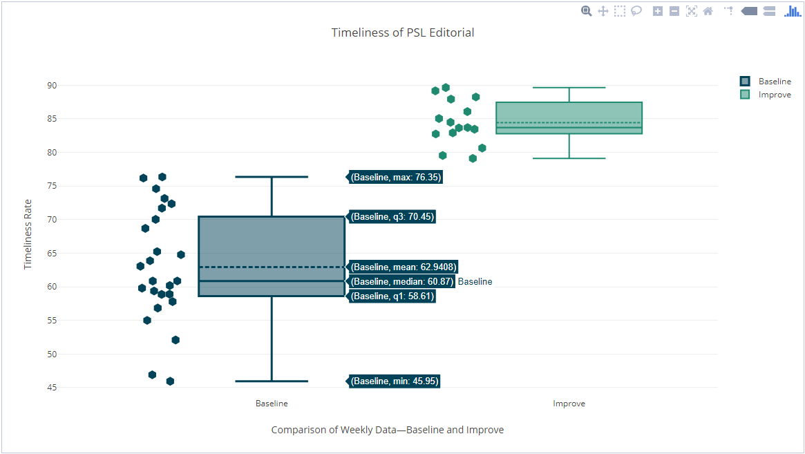
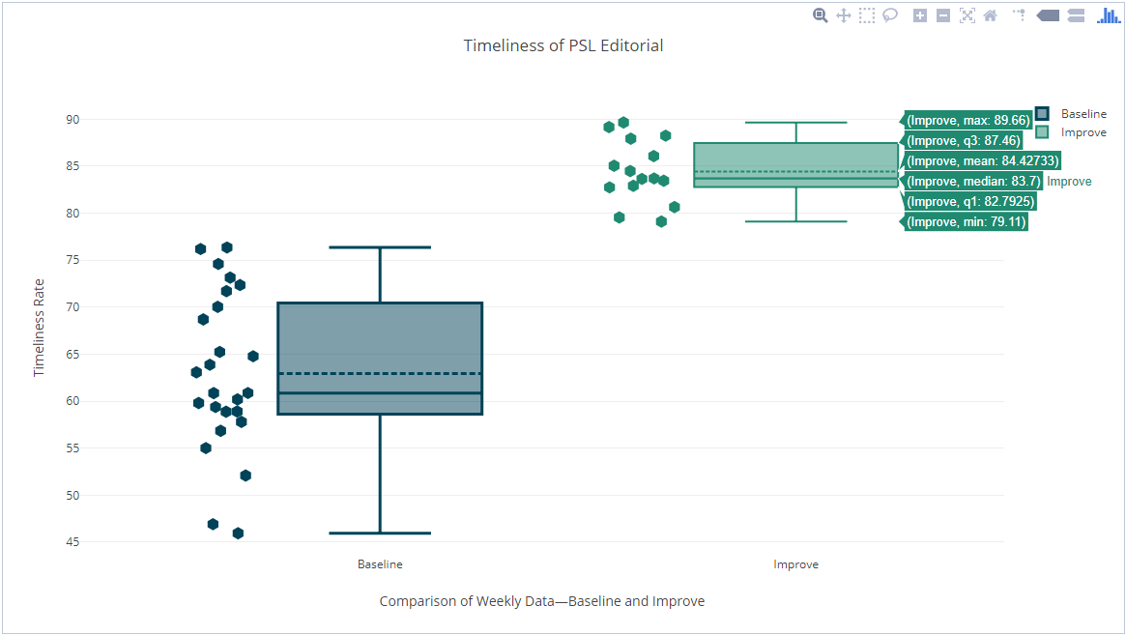
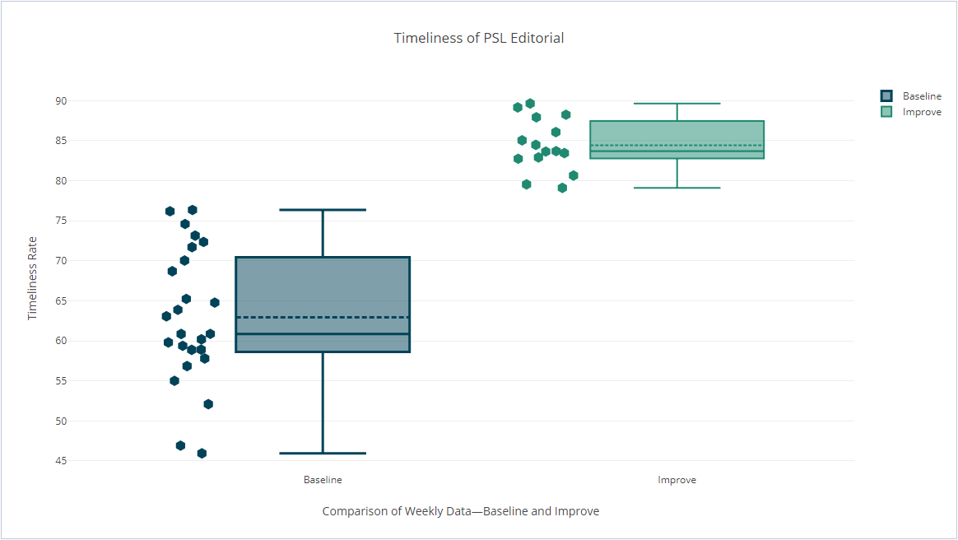
Define
Measure
Control
Analyze
Improve
Box Plot—Baseline v Improve Data
23

Slide 24
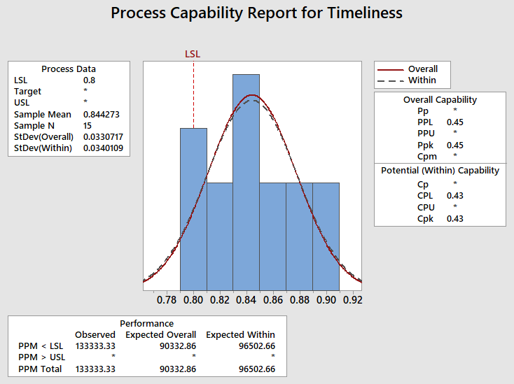
Define
Measure
Control
Analyze
Improve
Process Capability—Improve
24
Notes:
Process capability index (Cpk) now at a positive value, means that the process is more capable of achieving 80% target

Slide 25
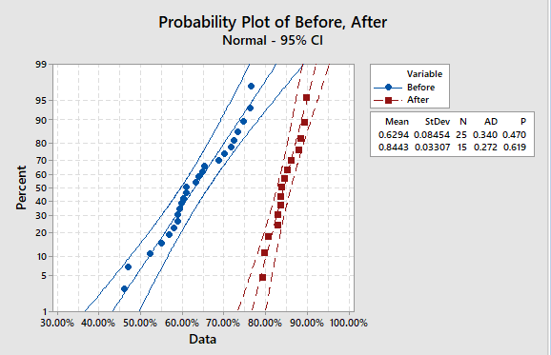
Define
Measure
Control
Analyze
Improve
Full Implementation
P value is greater than .05. Data follows a normal distribution.
25
Notes:
Test of normality—for the data to be considered normal, at least 95% of the data points should be within the confidence bands.
Also, if the p value is greater than 0.05, then we reject the hypothesis that the data is not normal

Slide 26
Define
Measure
Control
Analyze
Improve
Improve Result
From the baseline measure of 62%, the pilot test has improved the timeliness rate for PSL Editorial to 84%, exceeding the target of 80%.
26

Slide 27
FMEA
Define
Measure
Analyze
Improve
Control
Process Step | Key Process Input | Potential Failure Mode | Potential Failure Effects | SEV | OCC | DET | RPN
Timeliness measurement | Collated Asana CSVs for all editors | Collection and measurement not standardised | Incorrect output figures | 6 | 9 | 2 | 108
 |  | Asana downtime, limitations and downgrades | Editors unable to carry out and complete tasks | 10 | 2 | 1 | 20
 |  | Dissatisfaction of editors with measurement system | Non-conformance to timeliness targets | 3 | 1 | 2 | 6
 |  | Conflicting focus on measures, ie quality vs timeliness | Quality might go down when | 9 | 6 | 4 | 216
Task reallocation | List of tasks for reallocation | Editors' reluctance to take on reallocated tasks | Editorial bandwidth not optimised | 2 | 1 | 1 | 2
 |  | Author's preference to have only one editor working on an assignment | Editorial bandwidth not optimised | 3 | 5 | 1 | 15
 |  | Challenges in reallocating Level II tasks | Risk of delaying the completion of Level II tasks | 8 | 6 | 2 | 96
 |  | Editors not placing tasks in the pool due to metrics consciousness | Editorial bandwidth not optimised | 6 | 3 | 5 | 90
 |  | No accurate measure/forecast of editor's capacity | Difficulty in performing reallocation | 4 | 9 | 1 | 36
Adjusting due dates of tasks | TAT guidelines | Authors' resistance to have due dates changed | Risk of having tasks with incorrect due dates to go overdue | 2 | 3 | 1 | 6
 |  | Differences in work schedules (eg assigning an urgent task at the end of the shift) | Editors not able to complete urgent tasks when assigned past their shifts | 9 | 4 | 3 | 108
27

Slide 28
FMEA
Define
Measure
Analyze
Improve
Control
Potential Failure Mode | Potential Failure Effects | Potential Causes | Action Items | Recomputed RPN
 |  |  |  | Before | After
Collection and measurement not standardised | Incorrect output figures | Different methodologies can be used in Asana to extract CSVs | JDI project: automation of CSV extraction from Asana (RPA) Create guidelines in extracting CSVs for alignment | 108 | 30
Conflicting focus on measures, ie quality vs timeliness | Quality might go down when editor is too focused on completing tasks within the due date | Tendency of editors to overlook quality just to meet due dates especially when processing a large volume of tasks | Balanced scorecard with Quality having greater weight compared to Timeliness and Productivity Training and regular calibration meetings discussing best practices on how to achieve good quality while meeting due dates at the same time | 216 | 63
Challenges in reallocating Level II tasks | Risk of delaying the completion of Level II tasks | Not all REPH editors are trained in Precedents and Visio | Train editors to work on Level II tasks Reassign Level II tasks to UK editors with bandwidth | 96 | 50
Differences in work schedules (eg assigning an urgent task at the end of the shift) | Editors not able to complete urgent tasks when assigned past their shifts | Schedule of the authors can be 2-3 hours later than that of REPH editors | Set a cutoff time (eg 9:30 PM PHT) and adjust the due date the next working day Endorse urgent tasks to UK editor if the task is really urgent but came towards the end of the shift | 108 | 28
28

Slide 29
Define
Measure
Control
Analyze
Improve
COPQ
Cost Category/Description |  | Number of Events | Average Time (min) | FTE | Ave. Labor Cost/min | Formula | Total Cost (Php) |  | Number of Events | Average Time (min) | FTE | Ave. Labor Cost/min | Formula | Total Cost (Php)
Tasks not completed on or before due date -- LNUK |  | 1800 | 120 | 1 | 26.27 | A*B*C*D | 5,674,320 |  | 1380 | 120 | 1 | 26.27 | A*B*C*D | 4,350,312
Tasks not completed on or before due date -- REPH |  | 4800 | 120 | 1 | 5.31 | A*B*C*D | 3,058,560 |  | 1800 | 120 | 1 | 5.31 | A*B*C*D | 1,146,960
Time spent on reallocation -- REPH |  | 1 | 7920 | 1 | 5.31 | A*B*C*D | 42,055 |  | 1 | 3960 | 1 | 5.31 | A*B*C*D | 21,028
Tasks at author review exceeding one day (REPH tasks) |  | 420 | 480 | 1 | 5.31 | A*B*C*D | 1,070,496 |  | 240 | 480 | 1 | 5.31 | A*B*C*D | 611,712
FTE Cost (REPH) |  | 1 | 126,720 | 1 | 5.31 | A*B*C*D | 672,883 |  | 0 | 126720 | 1 | 5.31 | A*B*C*D | 0
 |  | Savings (Before - After) | Savings Category
 |  | 1,324,008 | Soft
 |  | 1,911,600 | Soft
 |  | 21,028 | Soft
 |  | 458,784 | Soft
 |  | 3,715,420 | Soft_Total
 |  | 672,883 | Hard_Hard
Savings in PHP |  | 4,388,303 | Soft+Hard
Savings in USD |  | 82,798 | Total Savings
Savings in UKP |  | 61,807
29

Slide 30
RECOMMENDATIONS
To sustain the improvements made by this project, I recommend the following items to the process owners:
Have timeliness rate as part of the monthly reporting
Make timeliness part of the balanced scorecard for REPH editors
Revisit the existing turnaround time guidelines
30

Slide 31

SUCCESS STORY
Change is never an easy thing in the office, especially when it comes to introducing a measure to determine the ability of editors in meeting due dates across three locations. Thanks to the Lean Six Sigma tools and methodologies, presenting the current state and devising improvement solutions can be done more objectively and collaboratively, thus increasing the chances for success in introducing positive changes to a team of different geographies.
This Green Belt project would not have yielded the desired outcomes had it not for the full cooperation of the LNUK PSL Editorial teams in Manila, Iloilo and in London—as pointed out by your leaders, the greatest achievement that has come out of this project is the culture of awareness and cooperation among the three offices that’s more evident than ever. While the conclusion of this project would lessen my involvement in the team’s affairs now that I’ve moved to a new role, I do hope to continue working with PSL Editorial on future projects in my capacity as a Global Business Analyst and as an SCM.
This Lean Six Sigma Green Belt Certification means a lot to my career development, and I can’t be thankful enough to all the Operations Leaders, Project Team Members, and CI Managers who supported me in this undertaking. To those about to embark on their CI journey, heed my advice: challenge the status quo, look at problems from different perspectives, and be relentless in your pursuit of positive results.
31

Slide 32


